Slide 1

Quarterly GDP Nowcasting
Young Economics Program (YEP) batch. 8
MPD, OCE, Minecofin.
April 2024

Slide 2
Outline & Content
Introduction
Rationale & use (why Nowcasting?)
Variables and data
Methodology
Key steps
Nowcasting in practice—Eviews program
Illustrated results
References

Slide 3
Introduction
Monetary and fiscal policies depend on evaluations of current and short-term economic conditions
Data issues in terms of irregularity and timeliness of published data.
Nowcasting (forecast current—now) approach estimates current Qo GDP using HFIs available data
Bridge Equations (BEs) are small-scale models used to "bridge" the information contained in individual HFIs using single equations, with the Qo growth rate of GDP
multiple linear equations (MLEs) associating two or three indicators, which make sense from an economic or statistical point of view and fit well the data
BEs, MLEs and combination outperform other models incl. MIDAS, VAR, ARMA, DFM …..)

Slide 4
Rationale & use
NISR Qo GDP publication lags for a quarter (3 Mos)
Evaluate short-term macroeconomic conditions
Forecasting (nowcasting) of current Qo and next Qo (i.e., Q1 & Q2 2024)
Inputs/ assumptions to macroeconomic projections:
Macro-Framework (MF) projections
Quarterly Macro Fiscal Model (QMFM)
In-year assumptions for actual tax ratios and other estimations.

Slide 5
Variables & data sources
Indicator | Frequency | Delay | Source Institution | Starting date
CPI Headline, Urban | Monthly | 10 days | NISR | Jan 04
PPI | Published quarterly, data monthly | 4-6 weeks | NISR | Jan 05
broad money, credit to private sector | Monthly | 25 days | BNR | Jan 03
VAT receipts | Monthly | 20 days | RRA | Jan 06
Exchange rate (current prices, USD) | Monthly | 1 day | BNR | Jan 06
Imports/Exports of goods (volume, value) | Monthly | 20 days | BNR | 1998
Industrial production (beer, soft drinks, rice, cement, flour, milk, electricity, and water) | Published quarterly, data Monthly | Up to 2 months | NISR/BNR | Jan 2006
BNR’s Composite Indicator of Economic Activity (Real) | Monthly | 25 days | BNR | Jan 2012
Turnovers (Industry, construction, services, hotel, financial serv., Trade, transport) | Monthly | 1 month | NISR | Jan 2012
IIP (Index of Industrial Production) | Monthly | 1 month | NISR | Jan 2011

Slide 6
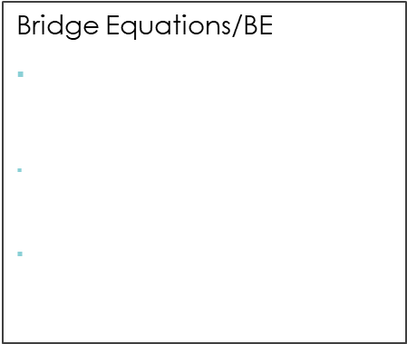
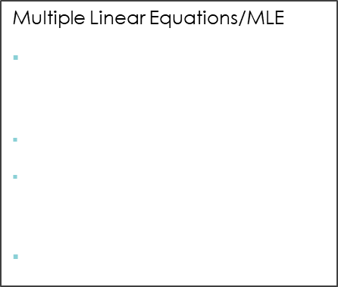
Methodology & steps of nowcasting
1. ARIMA forecast/projections
2. Data frequency conversions/aggregation
3. Estimation of equation
Automatic ARIMA extension of lagging Mo indicators based on specifications:
Starting points (selection of peaks in series)
Max & Min lags
Forecast length (e.g. Lags or missing obs.)
High to lower frequency
GDP is observed on Qo basis
Conversion from monthly to quarterly frequency for all HFIs using:
Average function for rates or stock indicators (e.g. CPI, ER, CIEA, IIP and PPI.
Sum function for other nominal or level or flow indicators (e.g., exports vol & val, cement, milk and drinks prod and turnovers)
Bridge Equations/BE
Bridge equation (BE) uses a HFI as regressor in a single equations with GDP
$\operatorname{dlog}\left(GDP\right)= α+ β_{1}{dlog⁡(GDP)}_{t−1}+… β_{4}d{log⁡(GDP)}_{t−i}+ γ_{1}d{log⁡(HFI)}_{t}+γ_{2}{dlog⁡(HFI)}_{t−1}+…γ_{5}{dlog⁡(HFI)}_{t−j}+ε$
ARDL models (better fit than OLS)
Multiple Linear Equations/MLE
3 Eqs represent supply, demand and production, monetary and services sector
$\operatorname{dlog}\left(GDP\right)=β_{0}+β_{i}\log\left({HFI}_{i}\right)+ ε$
${HFI}_{i} r$epresents cpi, turnovers, money supply, CPS and electricity production
OLS Estimation is used
4. Forecast (static) of BEs & MLEs
5. Forecast evaluation (FE) & averaging
6. Seasonal adjustment (sa)
Forecast for BEs and MLEs to obtain next Qo using specifications:
Series at levels (no transformation like diff or dlog)
Static forecast as forecast method
Forecast sample (i.e., 2024Q1 2024Q2)
Out-of-sample (actuals included in forecast sample( i.e., 2017Q1-2024Q2)
Forecast evaluation for FE statistics & graph as output
Independent evaluation of BEs and MLEs forecasts for each equation using:
FE methods (simple mean, MSE, MSE ranks,, simple median and least squares)
FE statistics for forecast accuracy/uncertainty (RMSE, MAE, MAPE, SMAPE, Theil’s U Statistics) to select ones with least forecast errors.
Independent FA of 10 Bes & 3 MLEs and combine the outcome (2 series to 1 (BE &MLE) using corr. least FE statistics
Final GDP s.a—combination/average of BE& MLE
Final Real GDP (FA of BE & MLE)
Not seasonal adjusted (Ann yoy % change)
Seasonally adjusted using EVIEWS built in function (X12)
Not adjusted and SA don’t deviate much
FA of (individual) sa indicators gives minor deviations
Notes:
Common Statistical Measures for Forecast Uncertainty/accuracy 1. Bias: the difference between the forecasts and the correct outcome, 2. Variance (“standard forecast error,
SE”) sqrt of (FE-BIAS), 3. MSE—combination of SE &BIAS, 4. RMSE sqrt of MSE, 5. MAE and MAPE 6. Theil’s U Statistics for forecast accuracy (U1) and quality (U2)—compares forecast with benchmark or naïve forecasting model. Forecast evaluation statistics worsen as if forecast horizon increases.

Slide 7
Key steps for nowcasting
Update available monthly data (i.e., turnovers, production and exports) from different sources
ARIMA forecast for missing (identify best starting points);
Data aggregation (transformation from monthly to quarterly using summation& average functions);
Bridge and Multiple Linear equations estimations (ARDL and OLS);
Static in-sample forecasting for all BEs & MLEs equations
Forecast errors evaluation using forecast evaluation methods and evaluation statistics incl. RMSE, MAE, MAPE, SMAPE, Theil Inequality Coefficients U1 and U2);
Selection of best BEs and MLEs forecasts (i.e., 10 BE & 2 MLE forecasts);
Forecast averaging/combination (using least errors forecast evaluation method) –average 10 BEs into 1 & 2 or 3 MLEs;
Forecast evaluation and average for 1 BE & 1 MLE for final combined GDP;
Seasonal adjustment for final GDP

Slide 8
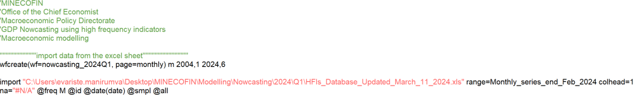
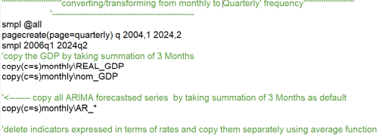
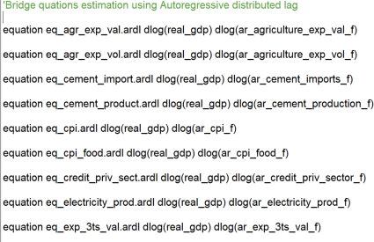
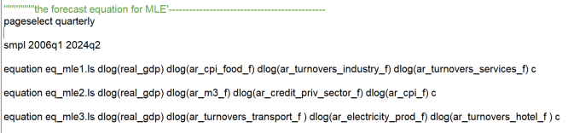
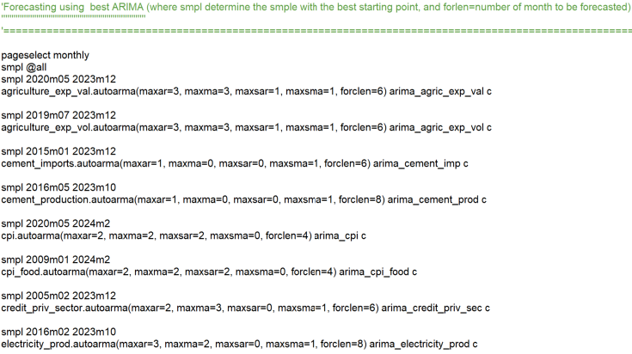
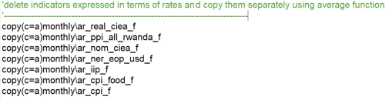
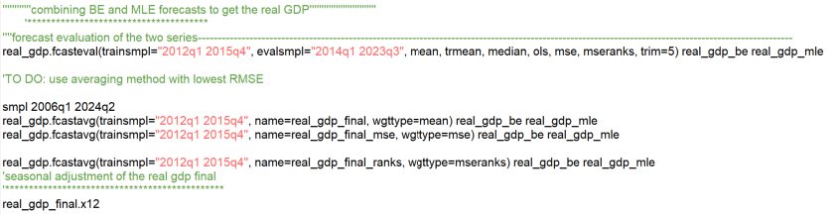
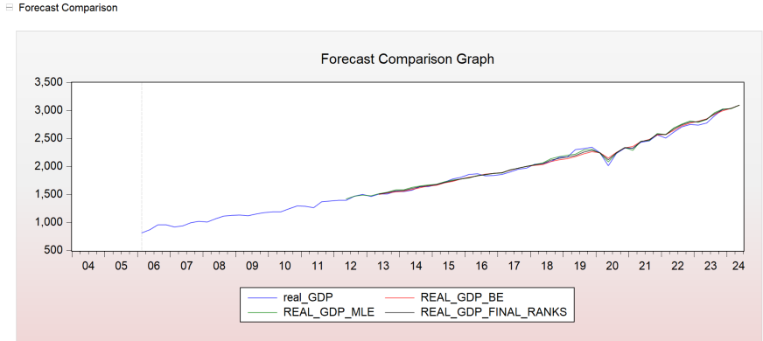
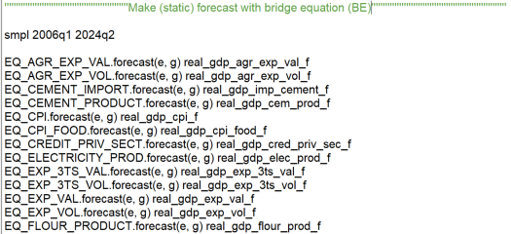
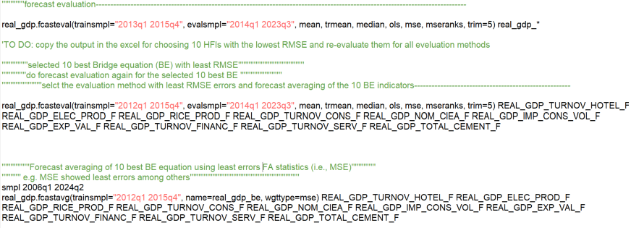
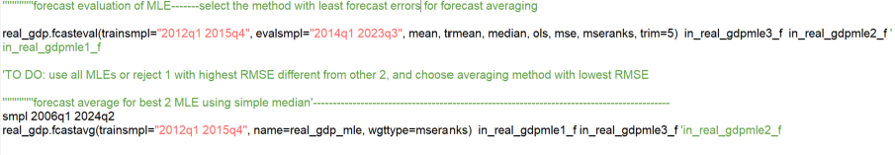
Nowcasting in practice—highlights from EVIEWS program
1. ARIMA forecast/projections
2. Data frequency conversions
3. Estimation of equations
6. Final GDP FA and seasonal adjustment (sa)
4. Forecast (static) of BEs & MLEs
5. Forecast evaluation (FE) & averaging
Notes:
Common Statistical Measures for Forecast Uncertainty/accuracy 1. Bias: the difference between the forecasts and the correct outcome, 2. Variance (“standard forecast error,
SE”) sqrt of (FE-BIAS), 3. MSE—combination of SE &BIAS, 4. RMSE sqrt of MSE, 5. MAE and MAPE 6. Theil’s U Statistics for forecast accuracy (U1) and quality (U2)—compares forecast with benchmark or naïve forecasting model. Forecast evaluation statistics worsen as if forecast horizon increases.

Slide 9
Results presentation/illustration
Selected GDP indicators (yoy %) for nowcasting brief

Slide 10
References
Kalisa, T. & Nsanza, J.U. (2018). Nowcasting GDP in Rwanda. BNR Economic Review, 12.”.
“Angelini, Elena, et al. (2011) "Short‐term forecasts of euro area GDP growth." The Econometrics Journal 14.1: C25-C44.”

